Slide 1
Assessment of Low-Carbon Technologies in the Iron and Steel Industry
Tsinghua University & Saudi Aramco
Prof. LI Zheng
Institute of Climate Change and Sustainable Development，Tsinghua University
February 21, 2025

Slide 2
Overview of Research丨研究概览
Subject: Assessment of Low-Carbon Technologies in the Iron and Steel Industry
Sponsored by: Technology Strategy & Planning Department, Saudi Aramco
Objective:
The impending energy transition could usher in profound transformations within the steel sector. We aspire that this research can serve as a valuable decision-making support for policy makers and stakeholders in steel, hydrogen, and energy sectors in China, Saudi Arabia, and other regions around the world.
Project schedule:
Phase I： October, 2023-April, 2025
Major collaborators from Aramco:
Dr. Daniel De Castro Gomez Technology Strategy & Planning, Saudi Aramco
Dr. Mohammed Moniee Aramco Asia, Aramco Research Center - Beijing
Dr. Xin He Aramco Americas, Aramco Research Center - Detroit

Slide 3
Outline / 主要内容
1
研究背景和目标
Background and objectives
2
研究设计和创新点
Content design and novelty
初步研究成果
Preliminary results and highlights
3
下一步研究计划
Next step
4

Slide 4
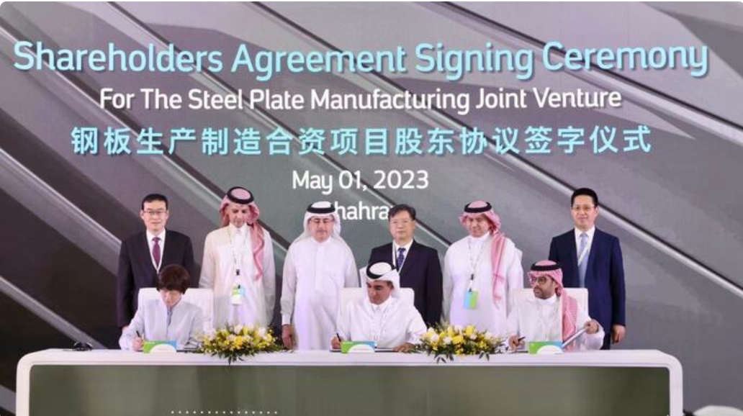
Background: of direct relevance to Aramco business
In May 2023, Saudi Aramco, Baowu Iron & Steel Co., and the Saudi Public Investment Fund inked a shareholder agreement to build a state-of-the-art, fully integrated steel factory in the Kingdom of Saudi Arabia (KSA).
This strategic move underscores the steel industry‘s commitment to explore new avenues for sustainable steel production in KSA.

Slide 5
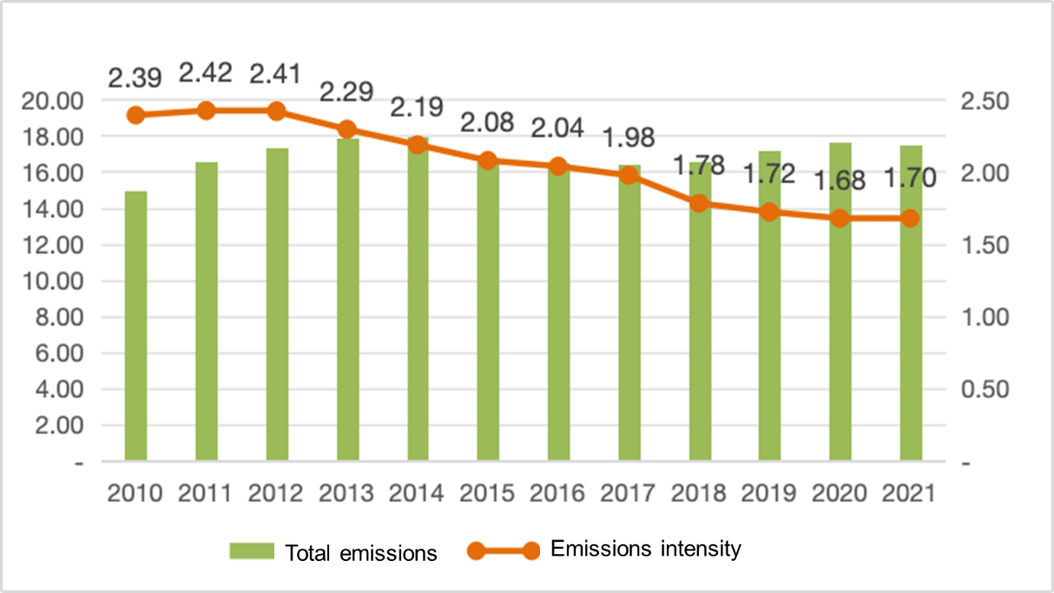
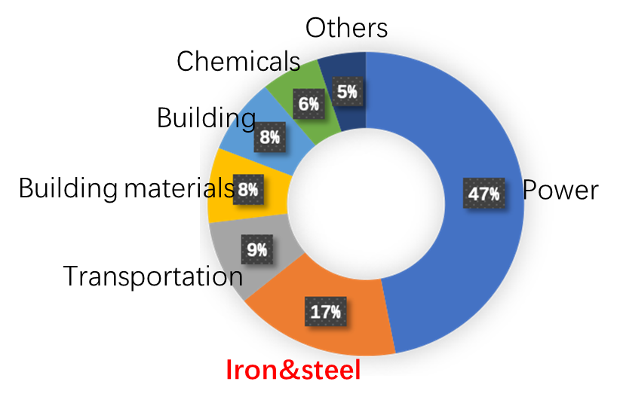
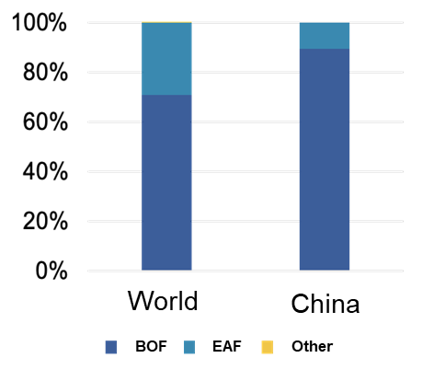
Background: decarbonizing China’s iron & steel industry
China has the world’s largest steel industry
Large scale: China produced 57% of the world‘s steel in 2020
High dependence on coal: 90% of steel capacity is BF-BOF, primarily coal-dependent.
High carbon emissions: 17% of China’s total carbon emissions in 2020.
Total carbon emissions (100 Mt) and average intensity(t/t steel)
Crude steel production by route in 2021
Carbon emissions sources in China
Data source: NBS, Tsinghua-ICCSD.

Slide 6
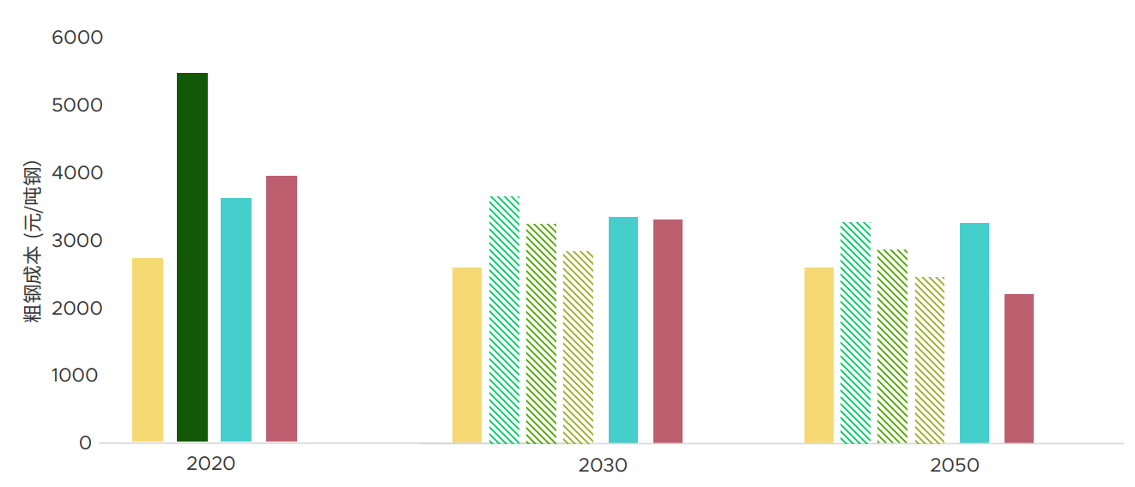
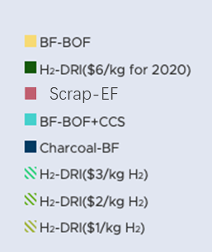
Background: decarbonizing China’s iron & steel industry
The application of carbon intensive BF-BOF will gradually phase down
The scrap-EAF route is constrained by the availability of scrap resources
Breakthrough technologies including H₂-DRI and CCS have great emission reduction potential
Route | Raw Material | t CO₂ /t crude steel
BF-BOF | Iron ore based | ~2.0
Scrap-EAF | Scrap based | 0.2~0.6
Gas/H₂-DRI | Iron ore based | ~0.9 / 0~0.4
BF-BOF-CCS | Iron ore based | 0.3~1.0
Crude steel cost (RMB/ton steel)
Carbon emission intensity of different routes
Steelmaking cost prediction of different routes
Data source: WRI, Tsinghua-ICCSD.
There are great need to understand future technology choices for the industry.

Slide 7
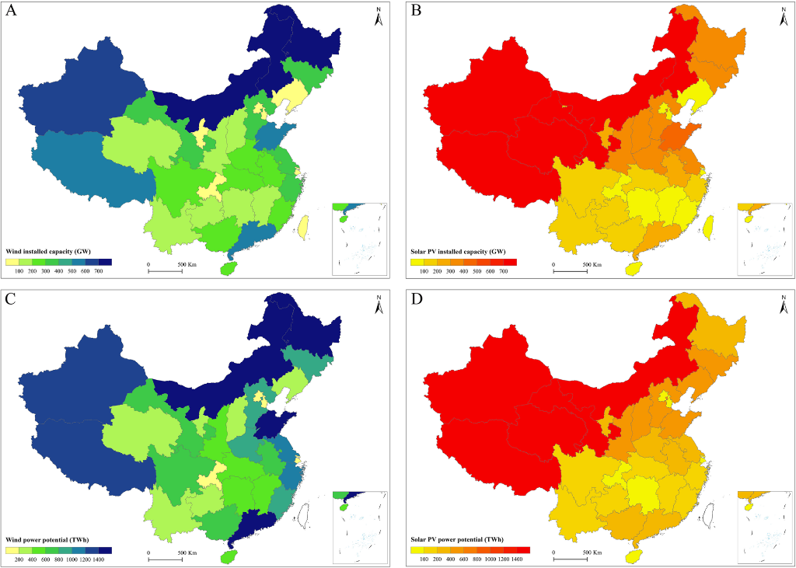
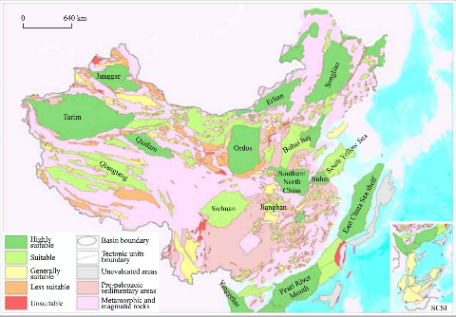
Background: regional capacity layout imbalance and mismatch
Regional Supply-Demand Imbalance: Currently, more capacity in the north and the east, an imbalance between steel production and consumption across regions.
Technology Potential Mismatch: Wind, solar and CCS potential vary significantly by region, mismatch between the existing capacity and technology potential.
100 Mt
Wind, solar generation and carbon storage potential in China
Steel capacity layout in 2020
Important to understand the layout change driven by energy transition

Slide 8
Research objectives丨研究问题
Emission reduction driven transition
How the future mode and cost of low-carbon steel production system evolve? Especially H₂-based routes
How will the spatial-temporal steel capacity layout evolve? (Considering interregional capacity relocation & transportation)

Slide 9
Outline / 主要内容
1
研究背景和目标
Background and objectives
2
研究设计和创新点
Content design and novelty
初步研究成果
Preliminary results and highlights
3
下一步研究计划
Next step
4

Slide 10
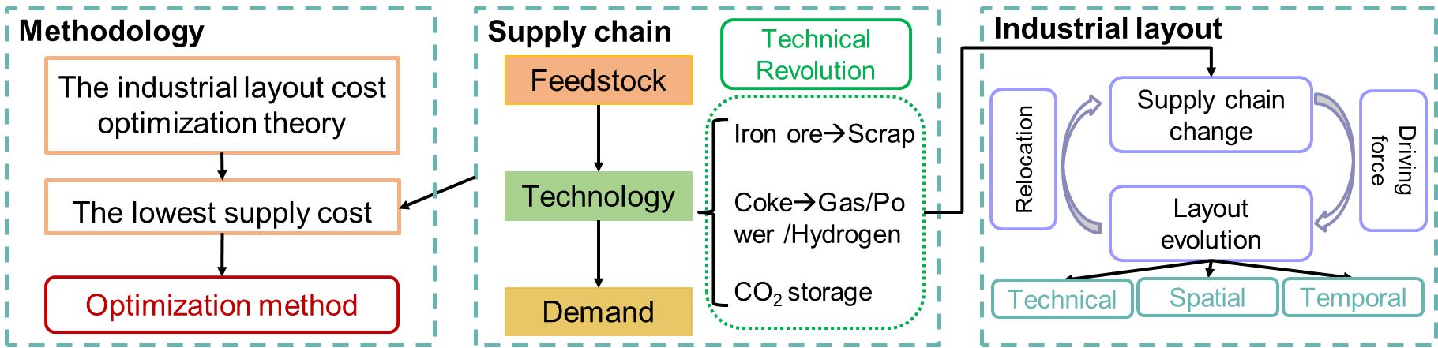
Research content丨研究内容
The spatial-temporal evolution of technology deployment and industrial layout results from the comprehensive evaluation of various elements along the supply chain driven by cost.
A new integration modeling methods should be established to reveal the industrial layout evolution:
Supply chain: Low-carbon technologies application, cost prediction of various elements
Layout evolution: An integrated approach for industry planning based on optimization, considering the economic optimality across the entire supply chain
建立模型，具备研究（供应链）组成技术的演变以及技术、经济、环境性能的变化的能力，并据此研究不同技术的适用性，以及供应链布局的演变
Notes:
建立一个模型，具备研究（供应链）组成技术的演变以及技术、经济、环境性能的变化的能力
并据此研究不同技术的适用性，以及供应链布局的演变

Slide 11
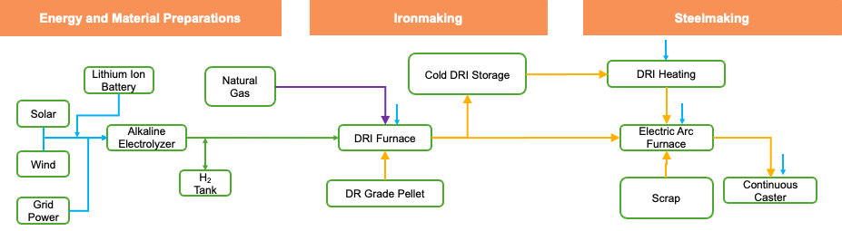
Research highlight 1丨研究创新点一
Flexibility Analysis of H₂-DRI-EAF system 氢能钢铁灵活生产系统建模分析
An hourly resolution system optimization model is developed, integrating electricity, hydrogen, iron, and steel production, storage, and consumption. The model evaluates the flexible operational modes of different production units and assesses the overall economic and environmental benefits of the system. This study unveils a paradigm shift in the temporal decoupling and flexible operation of production processes under renewable-centric H₂-DRI-EAF.
氢能钢铁灵活生产系统建模：建立了考虑电、氢、铁、钢的生产、储存、消费的小时级系统优化模型，评估了不同生产设备的灵活运行模式和系统整体的经济与环境效益，揭示了基于可再生绿氢DRI电炉炼钢技术的生产流程之间的时域解耦和灵活运行的范式转变的特征。
Flexibility measure | Description | Scenarios
 |  | EX | ALL
Electrolyzer load | Flexible operation of electrolyzers, with hydrogen storage in pressurized tanks | Yes | Yes
EAF load | Flexible operation of EAF through batch processes | Yes | Yes
DRI furnace load | Semi-flexible operation of DRI furnace, with DRI storage | No | Yes
Scrap blend ratio | Adjustable scrap blending ratio per batch in EAF | No | Yes
Steel demand | Variable hourly steel production within each demand period | No | Yes
Gas backup | With natural gas as a backup option in DRI furnace blending with hydrogen | No | Yes
Grid backup | With grid power as a backup option to supply electricity during shortage periods | No | Yes
One research paper to be submitted to Nature Energy, co-authored with Aramco

Slide 12
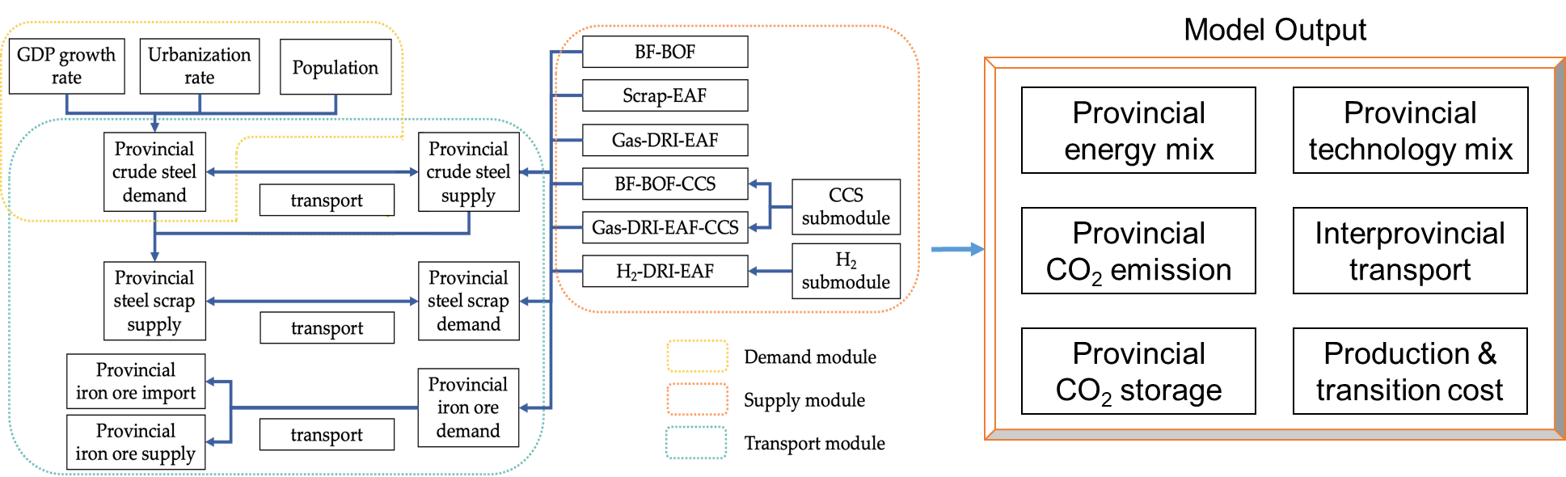
Research highlight 2丨研究创新点二
Industrial Layout Analysis 产业布局演变建模分析
This study explores the spatiotemporal evolution of the steel industry's industrial layout under the carbon neutrality target. It characterizes the provincial deep decarbonization transition pathways based on optimal industry chain perspectives and regional resource endowments. Furthermore, it delineates the spatiotemporal distribution of technological transformations, breakthrough technology application at the provincial level and the interprovincial relocation of production capacity.
刻画了基于产业链最优视角和资源禀赋地区差异性的分省深度脱碳转型技术路径，描绘了技术变革的时空分布规律，分省的突破性技术应用和产能跨省转移方向，揭示了碳中和背景下钢铁行业的产业布局时空演变规律。
Methodology: superstructure
Planning period: 2021~2060
Temporal resolution: year
Spatial resolution: province
Output: provincial pathway & industrial layout evolution
One policy proposal in preparation to be submitted to Relevant decision-making authorities

Slide 13
Outline / 主要内容
1
研究背景和目标
Background and objectives
2
研究设计和创新点
Content design and novelty
初步研究成果
Preliminary results and highlights
3
下一步研究计划
Next step
4

Slide 14
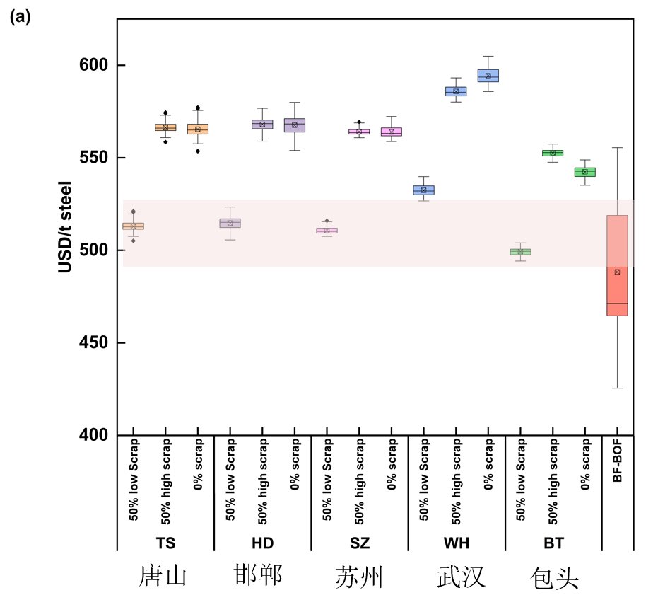
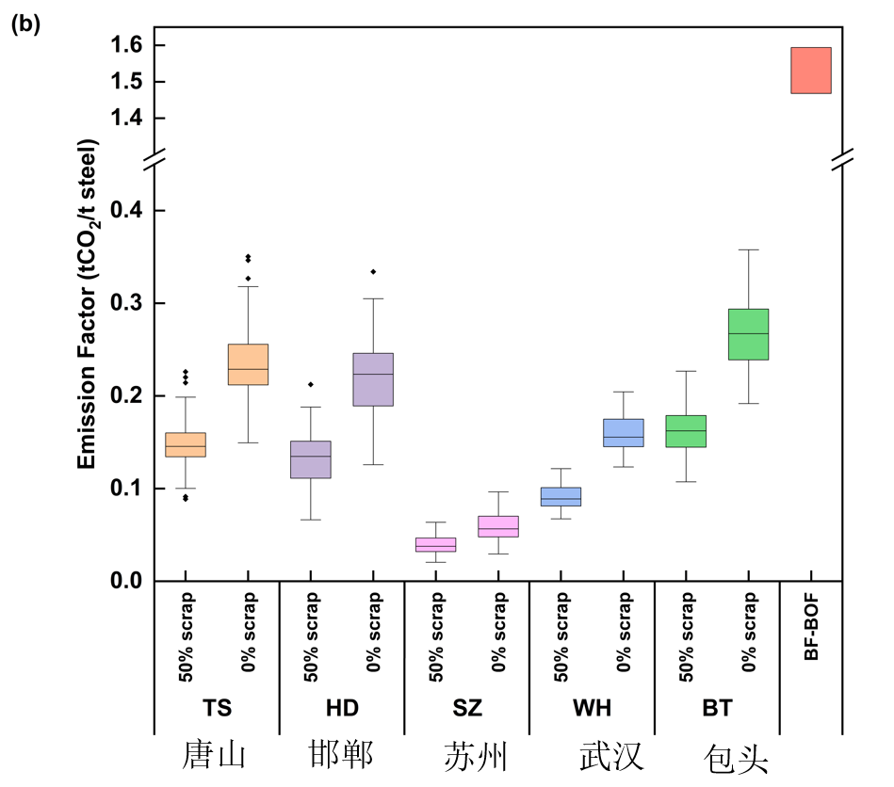
H₂-DRI-EAF can achieve near cost parity with BF-BOF by 2035
H₂-DRI-EAF can achieve near cost parity with BF-BOF by 2035 with 50% economically sourced scrap in most regions and an 85%+ reduction in emissions compared to BF-BOF
Less annual variations in LCOS for H₂-DRI-EAF than historical variations in BF-BOF costs
LCOS of blending 50% costlier scrap and 100% DRI routes remain higher than BF-BOF even under high historical fossil energy costs
Levelized cost of steel (LCOS) comparison in 2035
Emission factor comparison
Basic settings: 2016 configuration, $135/t for BF pellet and $160/t DR pellet prices; $286/t and $392/t for two scrap prices
Slide | 14

Slide 15
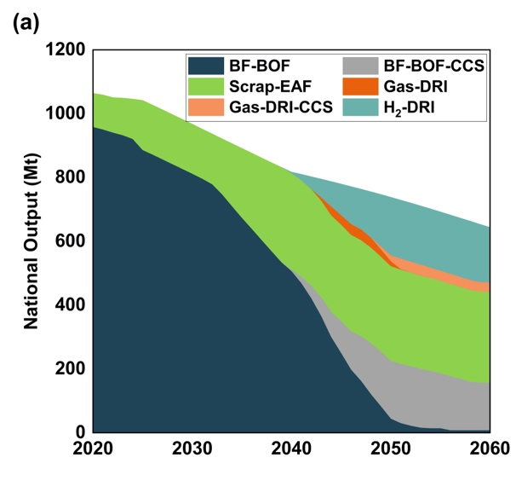
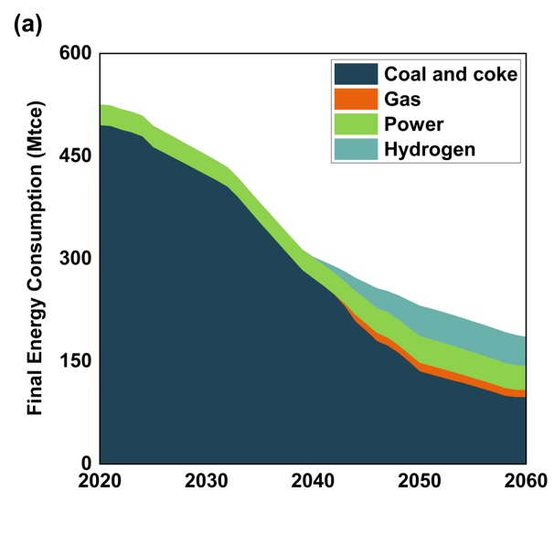
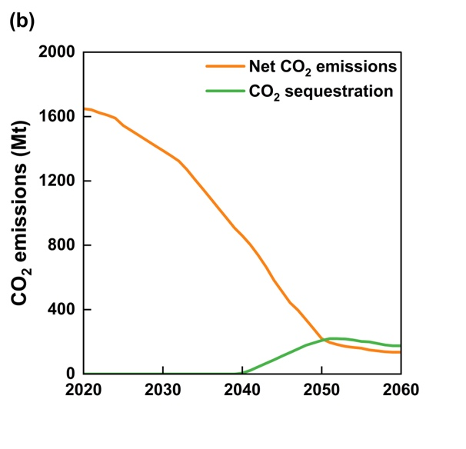
Scrap-EAF and H₂-based DRI will dominate the production
National steel demand is forecast to decrease to 645 Mt in 2060.
Technology mix: BF-BOF to Scrap-EAF, H₂-based and CCS routes.
Energy consumption is reduced from 530 million tons of standard coal equivalent (tce) in 2020 to 186 million tce in 2060. The ratio of hydrogen rises to 23% by 2060.
The remaining net emissions are 136 Mt in 2060, reduced by 92% of CO₂ emissions in 2020. By 2060, annual CO₂ sequestration is around 175 Mt.
Net and captured emissions of China’s iron and steel industry
National technology mix
Final energy mix

Slide 16
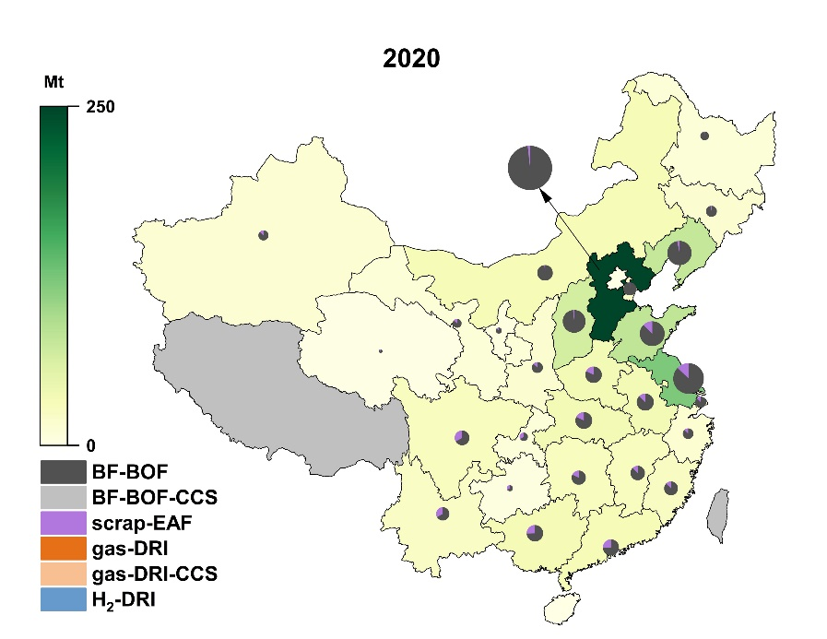
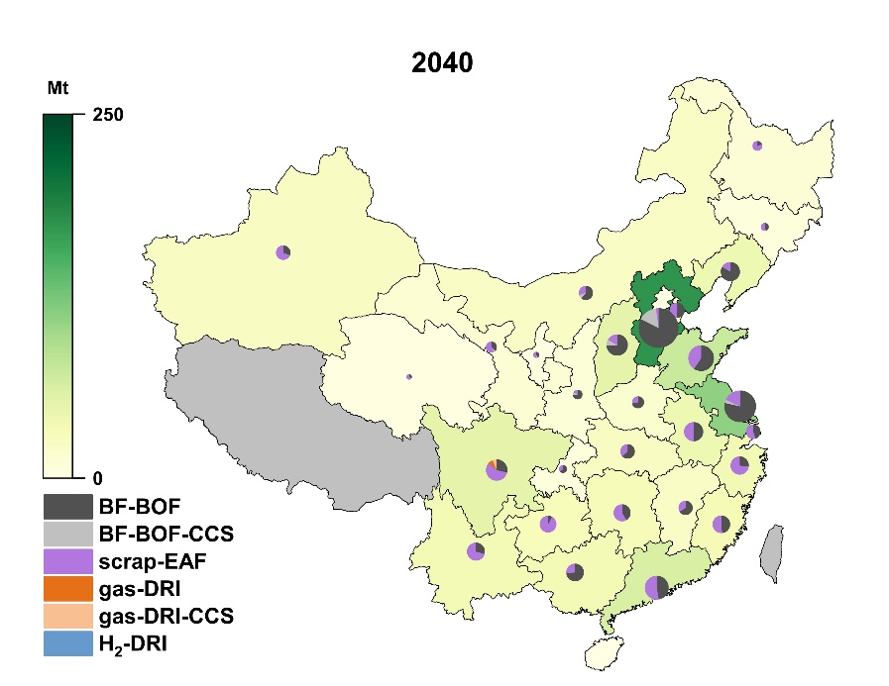
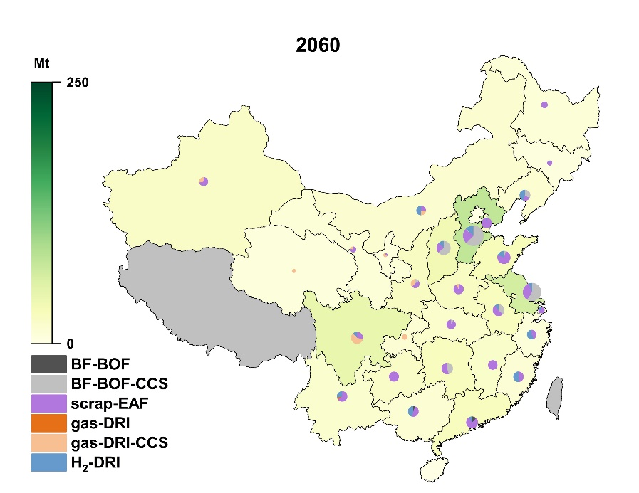
Capacity will gravitate towards regions fortified by clean energy
The layout is more even (North and Northeast China → Northwest, Southwest, and South China).
Provincial technology mix: scrap-EAF route is dominant in most provinces by 2060.
CCS is spatially highly concentrated in current major steelmaking provinces.
H2-DRI can be widely distributed in the I&S industry, especially in North, southwest China and coastal provinces (more than 0.8 Mt/y H2 production in each province).
Provincial Technology mix and layout evolution in 2020, 2040, 2060

Slide 17
Outline / 主要内容
1
研究背景和目标
Background and objectives
2
研究设计和创新点
Content design and novelty
初步研究成果
Preliminary results and highlights
3
下一步研究计划
Next step
4

Slide 18
1. Global Iron & Steel industry low-carbon transition
Extend the geographical scope to other key international markets such as Saudi Arabia and India
Evaluate low-carbon iron and steel technologies (particularly H₂-DRI), cost-effectiveness, implementation potential, and optimal spatial layout based on industrial layout theory and complex mathematical modelling
Provide critical insights into sustainable steel production strategies in KSA
Our research will provide essential technical and strategic support for advanced low-carbon steel production in Saudi Arabia.
Notes:
将研究扩大到国际市场，例如沙特和印度
评价低碳钢铁技术，特别是氢炼钢技术，的经济性（性能价格比），实施潜力，最佳布局
为沙特可持续钢铁生产提供洞察

Slide 19
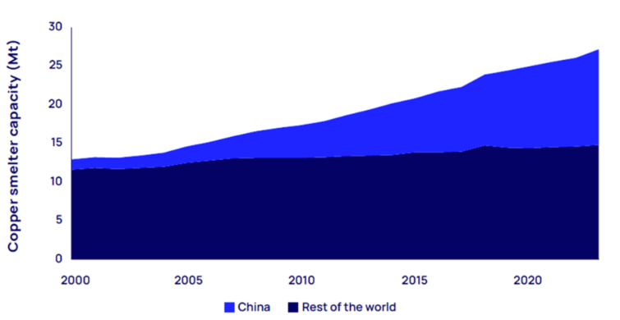
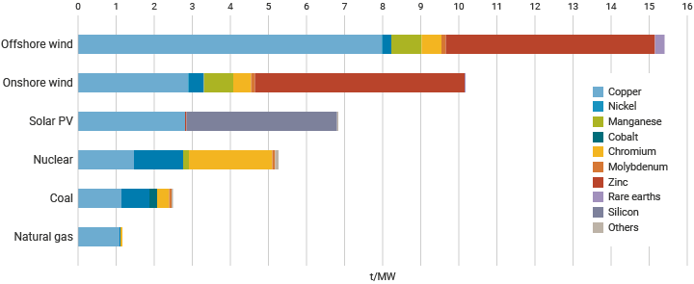
2. Copper supply chain evolution towards carbon neutrality
Copper is a strategic metal with important applications in renewable power generation, electric vehicles and efficient grid infrastructure.
China is a key participant in the global copper supply chain. Studying the technological development, supply and demand evolution, and trade trends of copper in China under its carbon neutrality targets will be of great value in estimating China's and the world's low-carbon transition and electrification processes.
China: 46%
Global copper smelter capacity (source: Wood Mackenzie)
Critical minerals required for different generating technologies (source: IEA)
Notes:
铜是战略金属，电气化关键金属，对中国和世界能源转型非常重要
研究中国铜的技术进展，供应的需求演变，贸易趋势，对中国和全球电气化过程，非常重要

Slide 20
Thank You!

